Slide 1
UML Modelling
Instructor: Mehroze Khan

Slide 2
Outline
What is Domain Model?
Why Domain Model?
Syntax of Domain Model
Examples on Case Studies

Slide 3
Revision up till now
Set of Requirements
Use Case
Diagram
High-Level and Expanded Use cases
Domain Model
Use case Identification
Boss test
Elementary Business Process
Size Test
Main Success Scenarios
Non-Functional Requirements
Functional Requirements

Slide 4
Domain Model
The domain model is created during object-oriented analysis to decompose the domain into concepts or objects in the real world
The model should identify the set of conceptual classes (The domain model is iteratively completed)
It is the basis for the design of the software
The domain model is also called conceptual model, domain object model or analysis object model

Slide 5
Domain Model
Illustrates meaningful conceptual classes in problem domain (Analysis phase)
It helps us identify, relate and visualize important information.
Represents real-world concepts, not software components
Software-oriented class diagrams will be developed later (during design phase)
It provides inspiration for later creation of software design classes, to reduce “representational gap.”

Slide 6
To visualize domain models the UML class diagram notation is used. It is also known as Analysis Class Diagram
However, no operations are defined in domain models
Only ...
domain objects and conceptual classes
associations between them
attributes of conceptual classes

Slide 7
Domain models are not models of software design
No responsibilities or methods.
Notes:
An artifact is a byproduct of software development that helps describe the architecture, design and function of software. Artifacts might be databases, data models, printed documents or scripts.

Slide 8
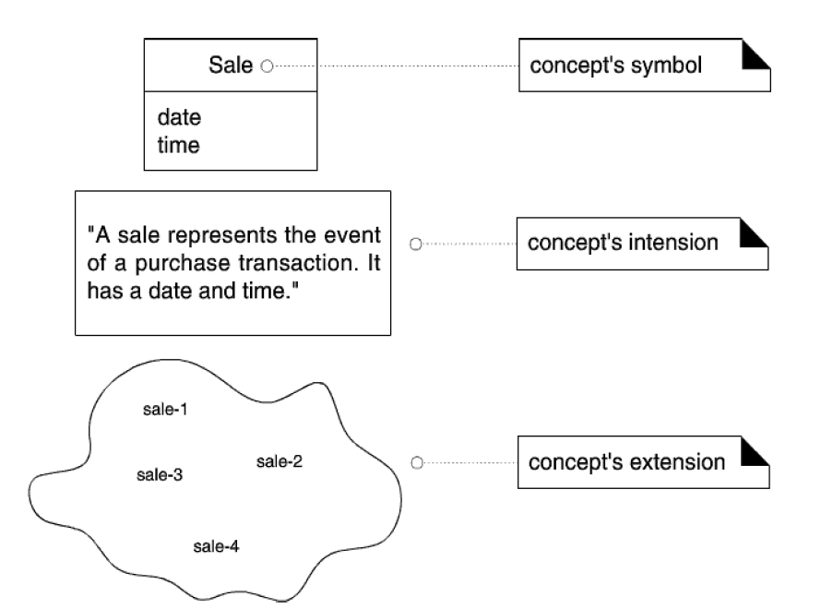
What are Concepts and Conceptual Classes?
Concept: is an idea, thing, or object. It has symbol, intension, and extensions.
Symbol --words or images representing a conceptual class
Intention --the definition of a conceptual class
Extension --the set of examples to which the conceptual class applies.

Slide 9
Why Domain Model?

Slide 10
Why do we need a domain model?
Gives a conceptual framework of the things in the problem space
Helps you think – focus on semantics
Provides a glossary of terms – noun based
Based on the defined structure, we can describe the state of the problem domain at any time.
Create a domain model to understand the key concepts and vocabulary
Lower gap between the software representation and mental model of the domain

Slide 11
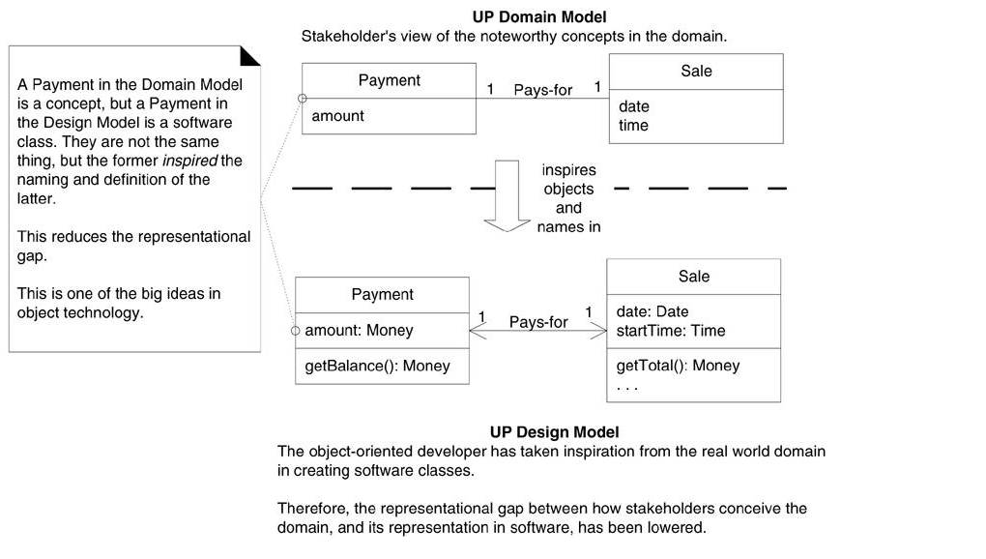
Lower representational gap with OO modeling

Slide 12
Syntax of Domain Model

Slide 13
Notation – UML Analysis Class Diagram
UML analysis class diagram is used to model a domain
Domain Class
Domain class consist of class name and attributes
Domain class does not have methods
Relation
A line with a label represents the relation between two classes
A relation has a cardinality constraint

Slide 14
Syntax of Domain Model
Class Name
Conceptual Class:
Student
age name
Association
Multiplicity/Cardinality
Registers
Registers
1
*
Attributes
Notes:
A multiplicity is a factor associated with an attribute. It specifies how many instances of attributes are created when a class is initialized. If a multiplicity is not specified, by default one is considered as a default multiplicity.

Slide 15
Relationships
There are mainly three kinds of relationships in UML:
Dependency
Generalization
Association

Slide 16
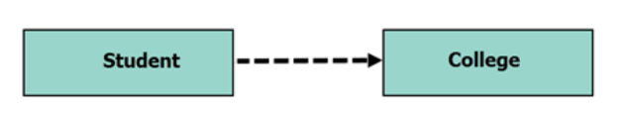
Dependency
A dependency means the relation between two or more classes in which a change in one may force changes in the other. However, it will always create a weaker relationship. Dependency indicates that one class depends on another.
In the following UML class diagram examples, Student has a dependency on College
Dependent Class

Slide 17
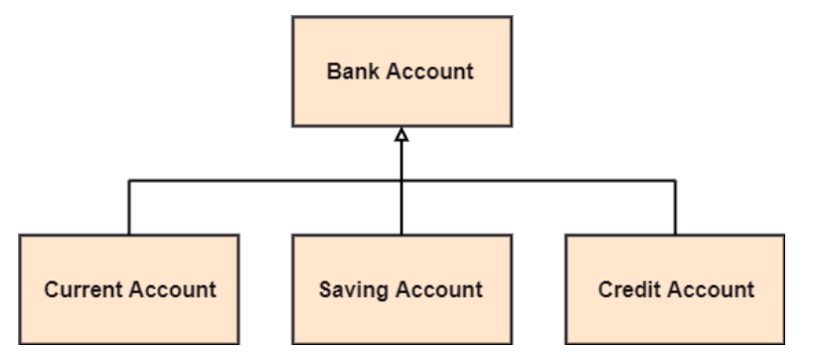
Generalization
A generalization is a relationship between a parent class (superclass) and a child class (subclass). In this, the child class is inherited from the parent class. For example, The Current Account, Saving Account, and Credit Account are the generalized form of Bank Account.

Slide 18
UML Association Notation
An association is represented as a line between classes with an association name.
Associations are inherently bidirectional.
Optional reading direction arrow is only an aid to the reader of the diagram.

Slide 19
UML Association Notation
“reading direction arrow”
It has no meaning except to indicate direction of reading the association label
Often excluded
Association name
POST
Records-current
Sale
1
1
multiplicity

Slide 20
Associations Names
Store
1
Contains
1..*
Captures
Paid-by
Post
Sale
Payment
1
1..*
1
1

Slide 21
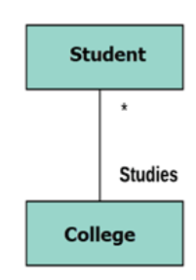
Multiplicity
A multiplicity is a factor associated with an attribute. It specifies how many instances of attributes are created when a class is initialized. If a multiplicity is not specified, by default one is considered as a default multiplicity.
Let’s say that that there are 100 students in one college. The college can have multiple students.

Slide 22
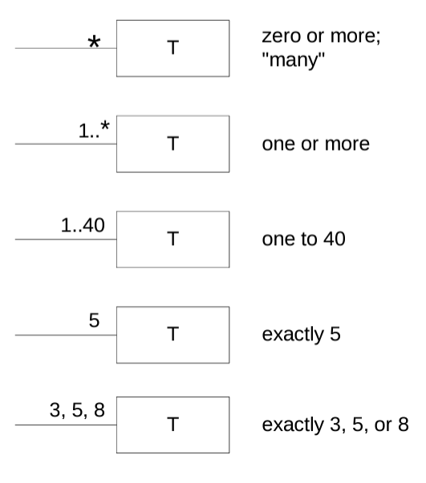
Multiplicity

Slide 23
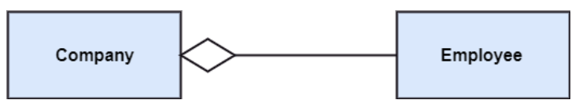
Aggregation
An aggregation is a subset of association, which represents has a relationship. It is more specific than association. It defines a part-whole or part-of relationship. In this kind of relationship, the child class can exist independently of its parent class.
Container Class
Contained Class

Slide 24
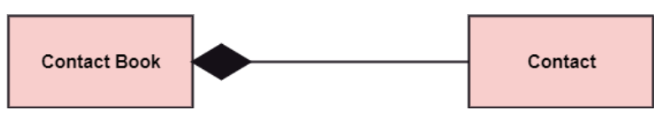
Composition
The composition is a subset of aggregation. It portrays the dependency between the parent and its child, which means if one part is deleted, then the other part also gets discarded. It represents a whole-part relationship.
A contact book consists of multiple contacts, and if you delete the contact book, all the contacts will be lost.

Slide 25
How to Create Domain Model

Slide 26
How to Create Domain Model
Find conceptual classes
Draw them as classes in a UML class diagram
Add associations and attributes

Slide 27
Finding Conceptual Classes
Three Strategies to Find Conceptual Classes
Reuse or modify the existing model if one exists
Use a Category List
Identify noun phrases in your use-cases

Slide 28
Method 1: Reuse or Modify Existing Models
There are published, well--‐crafted domain models and data models (which can be modified into domain models) for many common domains, such as inventory, finance, health, and so forth..
Reusing existing models is excellent, but out of the scope of this course

Slide 29
Method 2: Use a Category List
We can kick-start the creation of a domain model by making a list of candidate conceptual classes.
Table contains many common categories that are usually worth considering, with an emphasis on business information system needs.
The guidelines also suggest some priorities in the analysis. Examples are drawn from the
POS
Monopoly
Airline reservation domains

Slide 30
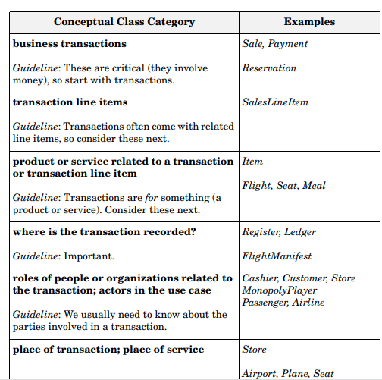
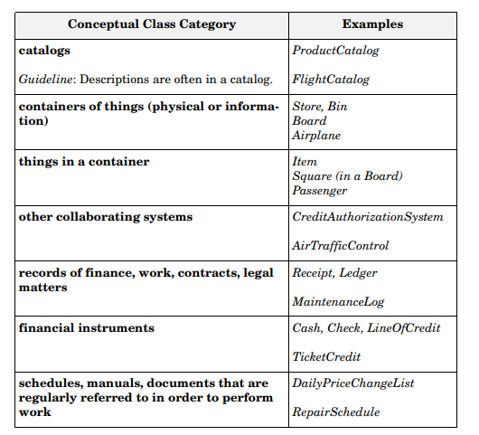
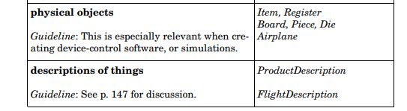

Slide 31
Method 3: Finding Conceptual Classes with Noun Phrase Identification
Another useful technique (because of its simplicity) is linguistic analysis: Identify the nouns and noun phrases in textual descriptions (use cases or other documents) of a domain and consider them as candidate conceptual classes or attributes.

Slide 32
Visualizing Domain Models

Slide 33
Archaeologist Management System
You have been asked to build a management system for a group of archeologists. The group is comprised of multiple teams of researchers. Each team has a letter ID (e.g., team A, team B). Each researcher belongs to one of the teams, and has an ID number, a first name, and a last name. There are two types of researchers: field staff and lab staff. Each field staff member has a favorite region (string). Each lab researcher supports up to 2 field researchers. Some researchers may not be supported by a lab researcher. The archaeologist group also manages an inventory of equipment. Researchers of any type may check out up to 3 pieces of equipment. Each piece of equipment has a serial number and replacement cost.

Slide 34
Archaeologist Management System Identify Nouns
You have been asked to build a management system for a group of archeologists. The group is comprised of multiple teams of researchers. Each team has a letter ID (e.g., team A, team B). Each researcher belongs to one of the teams, and has an ID number, a first name, and a last name. There are two types of researchers: field staff and lab staff. Each field staff member has a favorite region (string). Each lab researcher supports up to 2 field researchers. Some researchers may not be supported by a lab researcher. The archaeologist group also manages an inventory of equipment. Researchers of any type may check out up to 3 pieces of equipment. Each piece of equipment has a serial number and replacement cost.

Slide 35
Archaeologist Management System Identify Associations and Multiplicity
You have been asked to build a management system for a group of archeologists. The group is comprised of multiple teams of researchers. Each team has a letter ID (e.g., team A, team B). Each researcher belongs to one of the teams, and has an ID number, a first name, and a last name. There are two types of researchers: field staff and lab staff. Each field staff member has a favorite region (string). Each lab researcher supports up to 2 field researchers. Some researchers may not be supported by a lab researcher. The archaeologist group also manages an inventory of equipment. Researchers of any type may check out up to 3 pieces of equipment. Each piece of equipment has a serial number and replacement cost.

Slide 36
